Slide 1
Business Data Management
Capstone project
Presented by
Sukaniya K
21f1006420

Slide 2
BUSINESS DATA ANALYSIS - TAANUSHREE ENTERPRISES
Organisation background:
Proprietorship firm started in 2016
Involves B to B transactions
Services provided by Taanushree enterprises:
Supplying mineral water cans to commercial buildings and to local residences.
Renders transportation services, focused on the secure storage, handling, and transport of goods.
Recently started supplying stationery items and housekeeping products.
Problem statement:
Even though the business has been running steadily, there is a clear sign of growth stagnation.
The new client acquisition rate and the profits have slowed down since the covid pandemic.
The primary objective of the company is to grow its business by acquiring more clients and increasing profits

Slide 3
Objectives:
What should be our #1 focus right now? As the firm is handling multiple streams of products, the management team wants to know what areas should they invest in and in what areas they should divest.
To predict whether or not there were actually any patterns to capitalize on.
In brief, the Enterprise wants to know the current and past behaviour of the Company to check whether they are on actual track to increase the business Revenue.
Data Analysis process:
4 months sales bills
Converted to excel data
Excel data is divided based on the services provided by the Enterprise
Data cleaning process are applied to the created data spreadsheet
Data analysis methods:
Cluster analysis
Time series analysis
Region wise analysis
ABC / Pareto Analysis

Slide 4
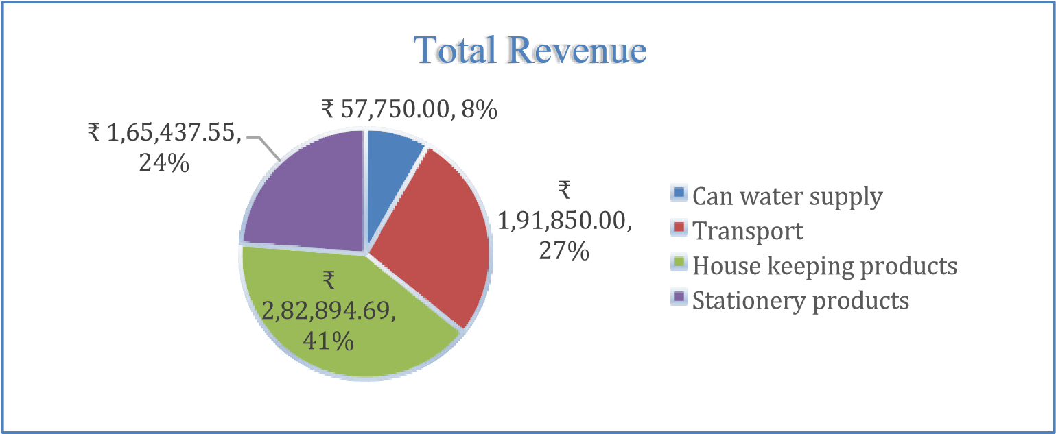











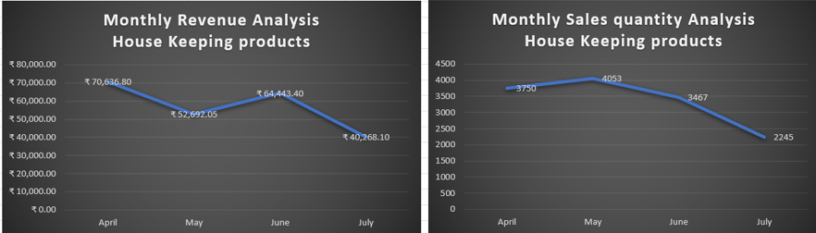
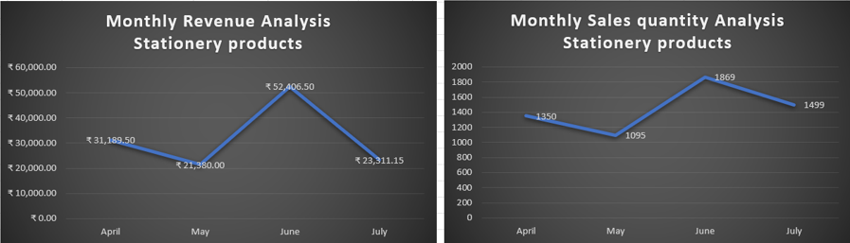
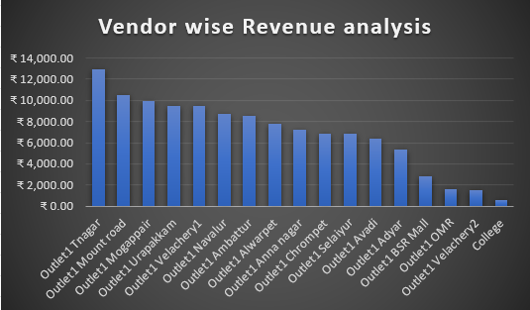
Results and findings
Can water supply region wise sales
-
Coimbatore
,
540
33
%
,
Chennai
,
1110
67
%
,
Chennai
Coimbatore

Slide 5
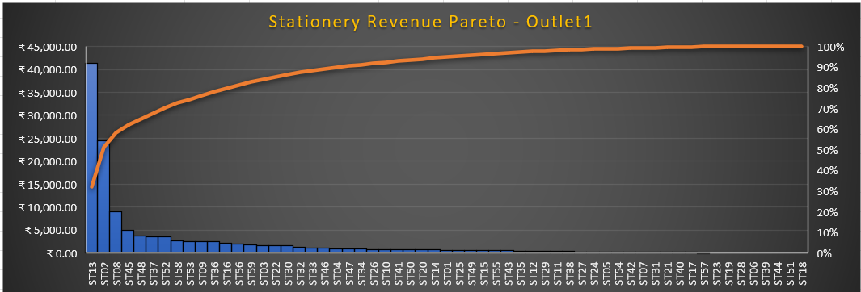
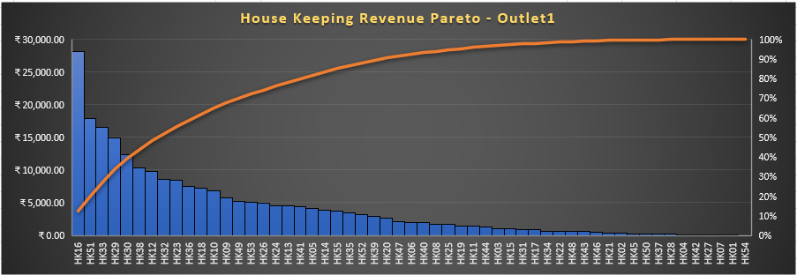
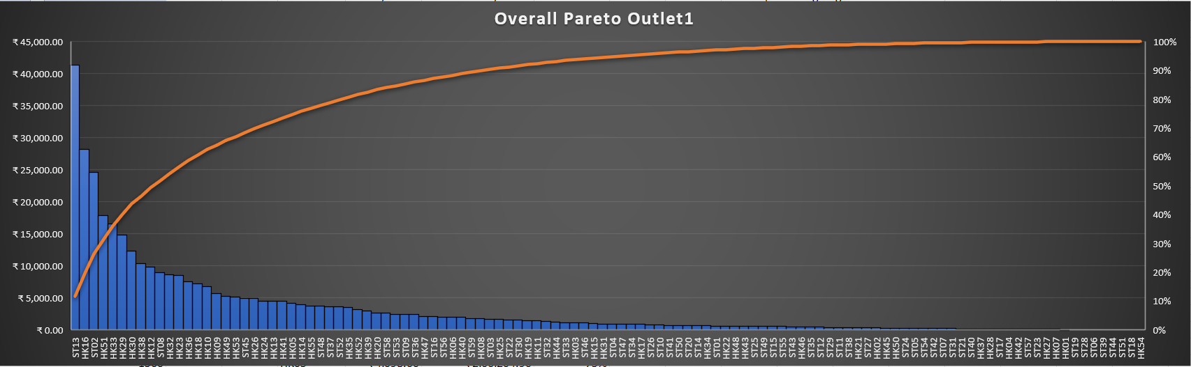
Pareto analysis
The Revenue analysis on Stationery products exactly follows 20 – 80 Pareto principle. The 12 items among 59 items are generating 80% of the total revenue.
The Housekeeping products alone are not following the Pareto as such 35% of its products generates 80% of the Revenue. The Business needs to concentrate almost 19 items to generate 80% of the revenue.
While doing overall product analysis, 25% of products giving 80% of revenue which almost follows the pareto principle and the products SK13 (Cello tape) and HK16 (Dustbin Cover) are the top selling products from both the services.

Slide 6
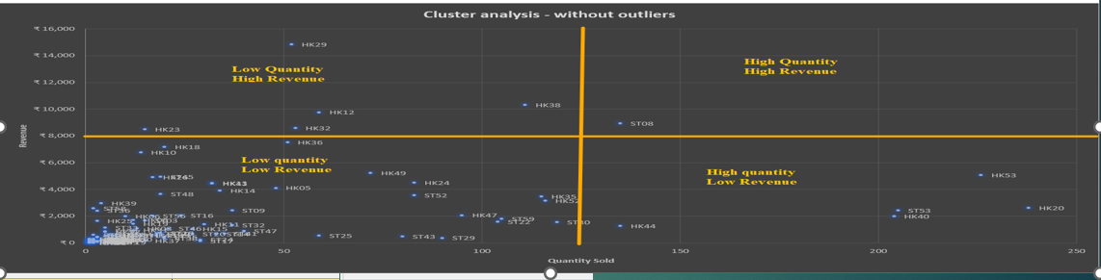
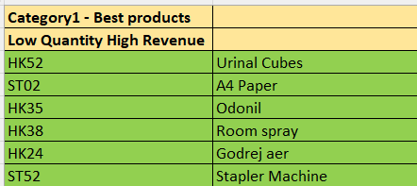
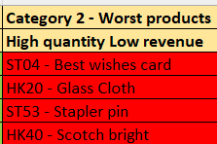
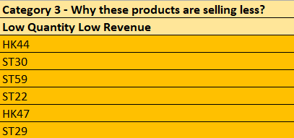
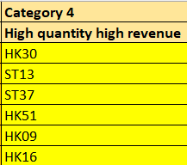
Cluster analysis:
The 114 products are categorised into 4 different categories and the snapshot of the same are given below. The Business needs to concentrate on the best-selling products more to generate more revenue. A separate space in inventory should be maintained for these best-selling products.

Slide 7
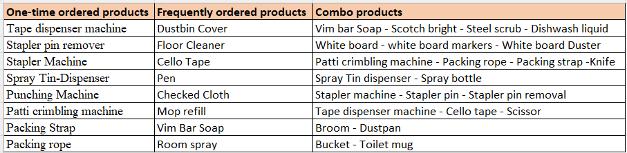
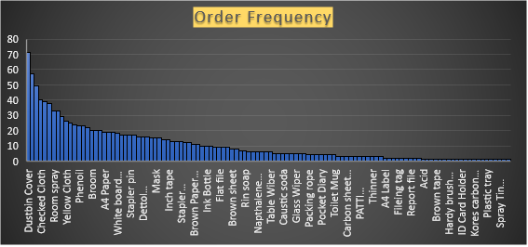
Order Frequency:
From 114 products, 23 products are frequently ordered products and some products are categorised as one-time ordered products. The below chart will be used to manage the inventory.

Slide 8
Interpretation of results
The revenue generated by newly launched services are considerably higher than the already available transport services and can water delivery services.
From the pareto analysis, the business owner should concentrate only on 25% of the products to generate 80% of the revenue.
Some of the products are selling more but yielding less revenue may cause inventory space problems.
As the Covid restrictions are laid down by the government and the fear of covid has gone from the people, buying rate of the top selling hygienic products such as Masks, hand wash, sanitisers etc are reduced comparatively.
From the vendor wise analysis, the company has started to get new clients in the month of July even in the other districts also which is a positive sign of growth.
We can categorise few products as one-time ordered products as they are long-lasting and mostly the vendors buy these products when they ordered for the first time. Examples: Crimbling machine, Tape dispenser machine, Spray dispenser, Sanitiser dispenser etc., The products also grouped together as Combo products as those are bought combinedly by the customers.
Currently, the enterprise has delivering can waters to only one Client in both Chennai and Coimbatore. Since we have many other customers for other services, we can try to expand our can water delivery services to those customers also.

Slide 9
Recommendations
Stay Organised: Keep accurate records of business finances. Record every transaction (customer billings and vendor payments) into the proper account at least weekly once and keep an eye on the bottom line.
Focus to increase the Client acquisition rate:
Taanushree enterprises have different Clients for their different services. Merging your marketing and customer service across all clients will enhance the company growth.
Strategically manage the inventory space by stocking up the products based on the identified categories (best/worst revenue generating products, one-time ordered products, frequently buying products, combo products) . By this way, we can save 20% inventory space.
Expand the business through online/web platforms. Reach customers in more ways than one.

Slide 10
The main objectives of the business analysis are to identify solutions for the following questions which is already stated in the proposal document. Hopefully our findings should help the business owners to get the answers for his questions.
What should be our #1 focus right now? As the firm is handling multiple streams of products, the management team wants to what areas should they invest in and in what areas they should divest.
Findings: The Enterprise should focus particularly to increase the Client acquisition rate by merging all of its customers to avail all their services.
To predict whether or not there were actually any patterns to capitalize on.
Findings: Actually, the trends show many patterns and the revenue curves are declining. With the help of those trends and analysis, the Owner can enhance the revenues which will make the curves sloping upwards.

Slide 11
Thank you

